Slide 1

Moodify
Cameron Roberts, Rosie Languet, Hunter Conway

Slide 2


Background
Problem: song classification and recommendation
Much work in this area using machine learning
Trung-Thanh Dang; Shirai, K., “Machine Learning Approaches for Mood Classification of Songs toward Music Search Engine,” Knowledge and Systems Engineering, 2009

Slide 3
Song Attributes
Acoustic attributes extracted by EchoNest:
Beat: consistency and strength of the beat (i.e. “Danceability”)
Energy: perceptual measure of intensity and powerful activity released throughout the track
Valence: musical positiveness conveyed by a track

Slide 4
Our Approach
Reasoning for mood classification and song similarity
Adapted from Music Mood Classification, by Michael Nuzzolo
Michael Nuzzolo (2015). Music Mood Classification. Electrical and Computer Engineering Design Handbook.

Slide 5
Music4Dance
Online song
database
Web Scraper
Beautiful Soup and Librosa (frequency analysis)
Parser.py
Sanitize and represent data for Companions
Companions

Slide 6
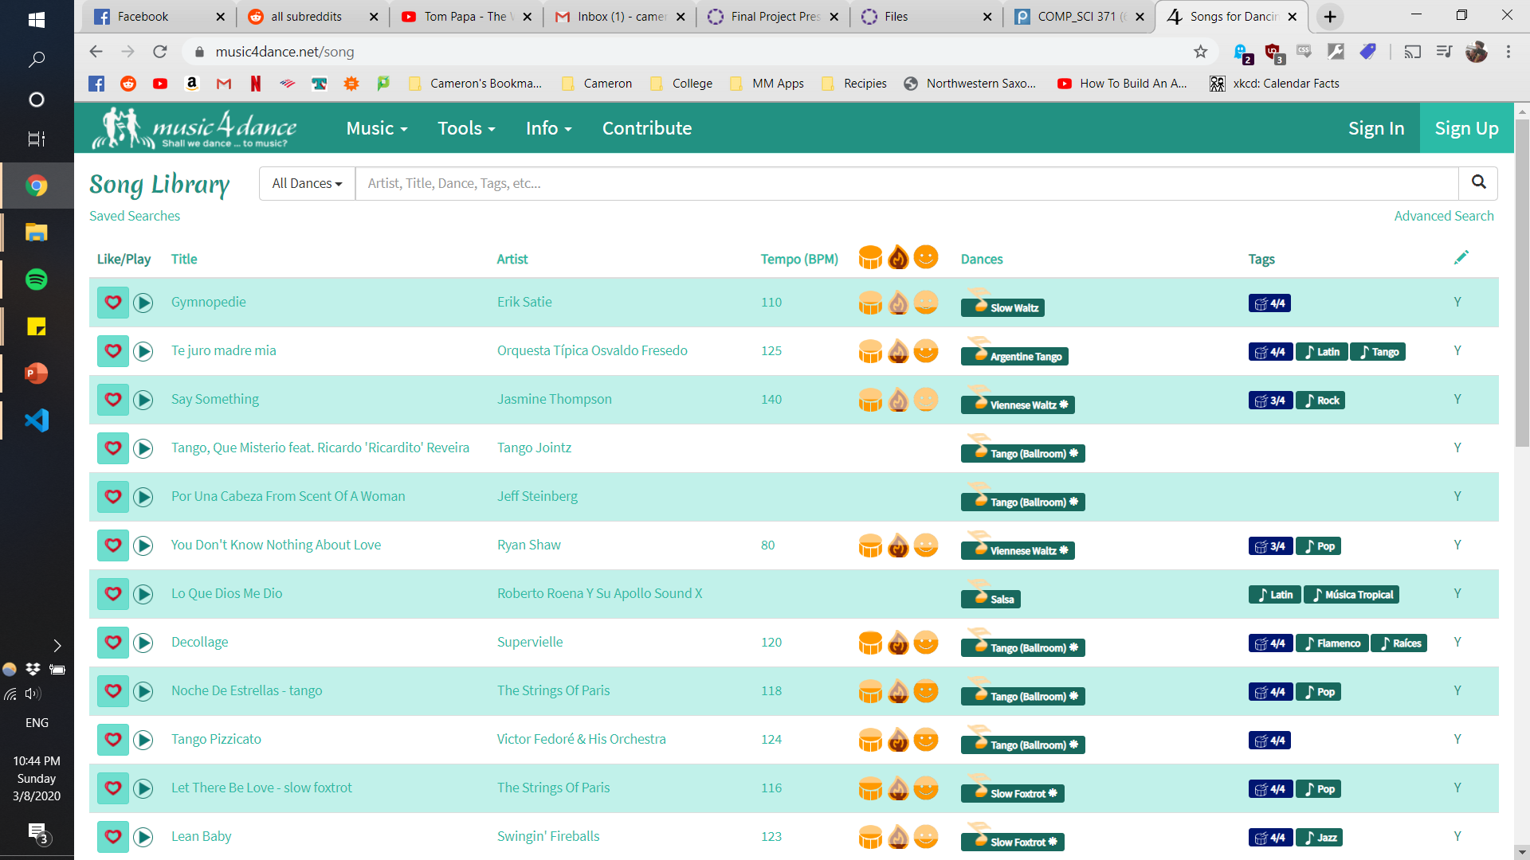
Music4Dance

Slide 7
Music4Dance
Beat
Energy
Valence
Various tags (style, meter, etc.)
~150 songs
1200+ Cyc statements
Easily extendable

Slide 8
Representation
(isa Gymnopedie Song-CW)
(composerOfMusicalCW ErikSatie Gymnopedie)
(TempoOfSong 95 Gymnopedie)
(EnergyOfSong lowL Gymnopedie)
(BeatOfSong mediumL Gymnopedie)
(PitchOfSong mediumL Gymnopedie)
(MeterOfSong "3/4" Gymnopedie)

Slide 9
Original
Mood | Intensity | Timbre | Pitch | Rhythm
Happy | Medium | Medium | Very High | Very High
Exuberant | High | Medium | High | High
Energetic | Very High | Medium | Medium | High
Frantic | High | Very High | Low | Very High
Anxious/Sad | Medium | Very Low | Very Low | Low
Depression | Low | Low | Low | Low
Calm | Very Low | Very Low | Medium | Very Low
Contentment | Low | Low | High | Low

Slide 10
Simplified
Mood | Energy | Pitch | Beat
Happy | Medium | High | High
Exuberant | High | High | High
Energetic | High | Medium | High
Frantic | High | Low | High
Anxious/Sad | Medium | Low | Low
Depression | Low | Low | Low
Calm | Low | Medium | Low
Contentment | Low | High | Low

Slide 11
Reasoning : Song Mood
(<== (songMood anxious ?song)
(BeatOfSong lowL ?song)
(PitchOfSong lowL ?song)
(EnergyOfSong mediumL ?song))
(<== (songMood content ?song)
(BeatOfSong lowL ?song)
(PitchOfSong highL ?song)
(EnergyOfSong lowL ?song))

Slide 12
Reasoning : Suitable Dance Styles
(<== (danceStyle tango ?song)
(MeterOfSong "4/4" ?song)
(greaterThanOrEqualTo ?tempo 90)
(lessThanOrEqualTo ?tempo 130)
(TempoOfSong ?tempo ?song))
(<== (danceStyle waltz ?song)
(MeterOfSong "3/4" ?song)
(greaterThanOrEqualTo ?tempo 84)
(lessThanOrEqualTo ?tempo 100)
(TempoOfSong ?tempo ?song))

Slide 13
Song Recommender
(userLikes ?song1) →
(userDisLikes ?song1) →
(userLikes ?attribute) →
(userDisLikes ?attribute) →
(userMayLike ?song2)
(userMayDisLike ?song2)

Slide 14
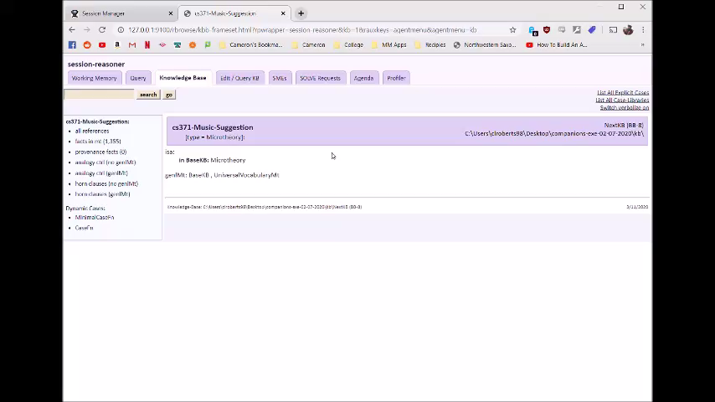
Demo

